Slide 1
Relational in-memory database for graph queries
Brandon Myers

Slide 2
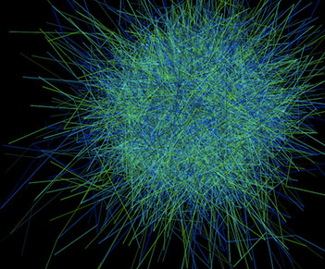


Graphs and databases

Slide 3
Graphs don’t live in a vacuum
mid | uid | scope | forward-of | text
M002 | 4 | group0 | M033 | FW: crab cakes…
M033 | 2 | group6 | nil | crab cakes…
2
3
blogger | follower | last-view-date
2 | 3 | 2013-05-04
5 | 2 | 2013-03-09
5 | 4 | 2012-01-01
4
5
Id | Name | Region | Employ-date
2 | Alice | NW | 2013-03-03
3 | Bob | E | 2010-01-02
4 | Carl | E | 2011-04-30
5 | Donna | SE | 2010-04-03
rater | ratee | Time-stamp | Rating
2 | 3 | 12450010 | 5
2 | 4 | 12330013 | 1
3 | 4 | 13145401 | 3

Slide 4
Hypothesis
A relational query system can be fast for graph applications
relational abstractions
hand coded
implementations

Slide 5
Approach
Datalog
Generated code (C++, Grappa)
Compiler
Notes:
generate code to execute simple graph queries and measure performance compared to relational systems

Slide 6
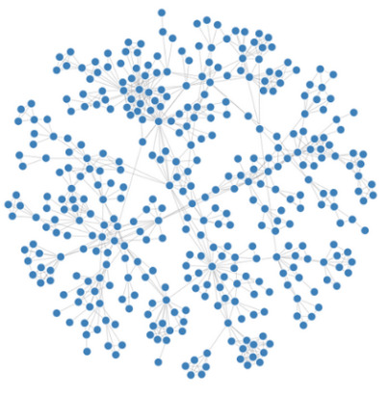
Simple graph patterns in Datalog
TwoHop (a,b) :- E(a,c), E(c,b).
Tri (a,b,c) :- E(a,b), E(b,c), E(c,a), a<b, b<c.
Notes:
select count(*) from (select distinct e1.src, e2.dst from E e1, E e2 where e1.dst = e2.src) z;
select count(*) from E e1, E e2, E e3 where e1.dst = e2.src and e1.src < e2.src
and e2.dst = e3.src and e2.src < e3.src
and e3.dst = e1.src;
W. Zhang, D. Zhao, and X. Wang. Agglomerative clustering via maximum incremental path
integral. Pattern Recognition, (0):–, 2013.
J. Caverlee and L. Liu. Countering web spam with credibility-based link analysis. In ACM
Principles of Distributed Computing (PODC), pages 157–166, 2007.

Slide 7



Datalog -> Relational algebra
A
A(x,y) :- S(x,z),
T(z,y),
y<10.
$$π_{x,y}$$
$$σ_{y<10}$$
$$⋈$$
scan S
scan T

Slide 8






RA optimization
A(x,y) :- S(x,z), T(z,y), y=10.
A
A
$$π_{x,y}$$
$$π_{x,y}$$
$$σ_{y<10}$$
$$⋈$$
$$⋈$$
$$σ_{y<10}$$
scan S
scan T
scan S
scan T

Slide 9



RA -> physical plan
A(x,y) :- S(x,z), T(z,y), y=10.
column indices
S(x,z) T(z, y)
1,2 3,4
A
GrappaEmit(1,4)
$$π_{x,y}$$
$$⋈$$
GrappaHashEquiJoin(2,3)
$$σ_{y<10}$$
GrappaLTSelect(4, 10)
scan S
scan T
GrappaScan(S)
GrappaScan(T)

Slide 10
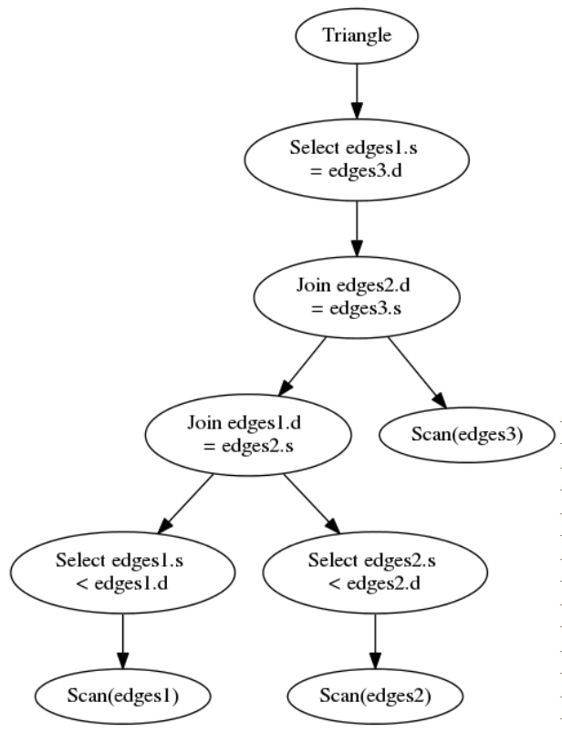
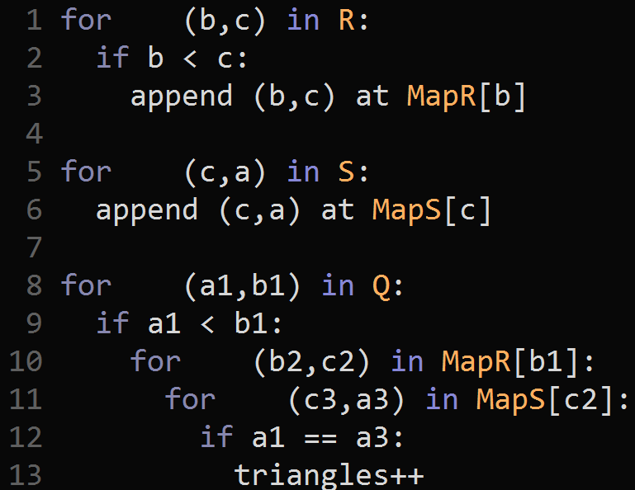
Pipelines
Tri(a,b,c) :- Q(a,b), R(b,c), S(c,a), a<b, b<c.
all
all
all
all
all

Slide 11
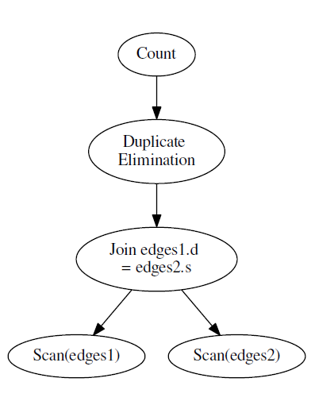
Grouping optimization
2H(a,c) :- E(a,b), E(b,c).

Slide 12
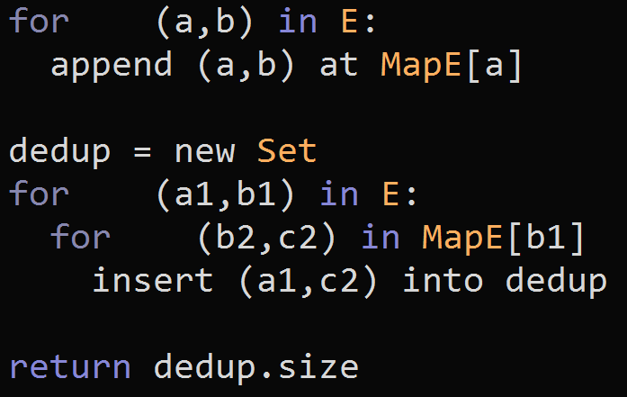
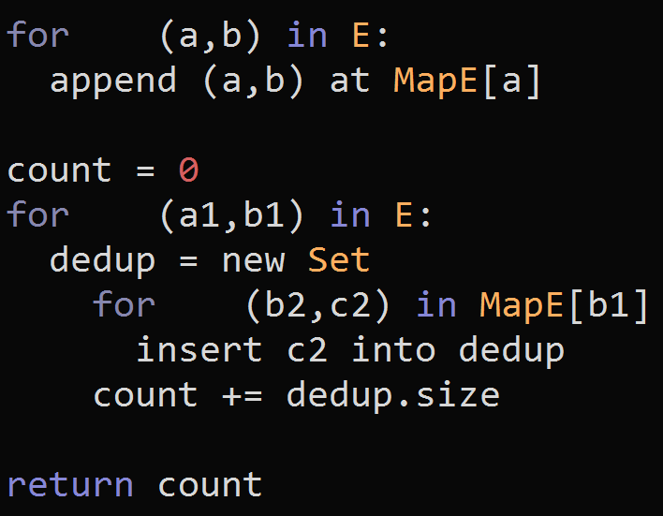
Grouping optimization
2H(a,c) :- E(a,b), E(b,c).
all
all
all
all
all
all
Set{(R,G)}
…
Set{(R,G),(O,G)}
Set{G}
…
Set{G}
Notes:
Better memory usage and better probe performance
factor of almost 5x performance

Slide 13
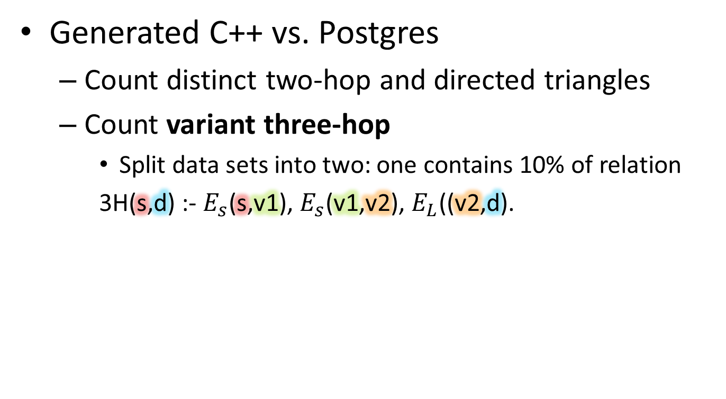
Experiments
Generated C++ vs. Postgres
Count distinct two-hop and directed triangles
Count variant three-hop
Split data sets into two: one contains 10% of relation
3H(s,d) :- $E_{s}$(s,v1), $E_{s}$(v1,v2), $E_{L}$((v2,d).
Notes:
Execution environment

Slide 14
Experiments
Data sets:
Dataset | # Vertices | # Edges | # Distinct 2-hop Paths | # Triangles
BSN* | 690K | 7.6M | 78,350,597 | 6,935,709
Twitter-sub^{ⱡ} | 170K | 4.5M | 1,056,317,985 | 14,912,950
com-livejournal* | 4.0M | 35M | 735,398,579 | --
soc-livejournal* | 4.9M | 69M | -- | 112,319,229
^{ⱡ}H. Kwak et al 2010.
*http://snap.stanford.edu/

Slide 15
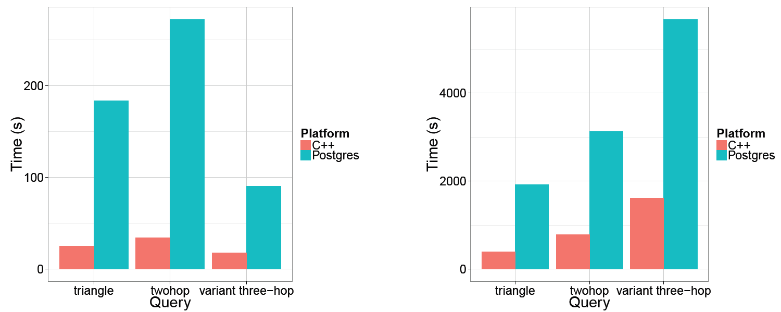
Query runtime (serial)
BSN
Twitter-sub
Notes:
Trend on data is different but we see on next slide it is exactly # of map/set lookups

Slide 16
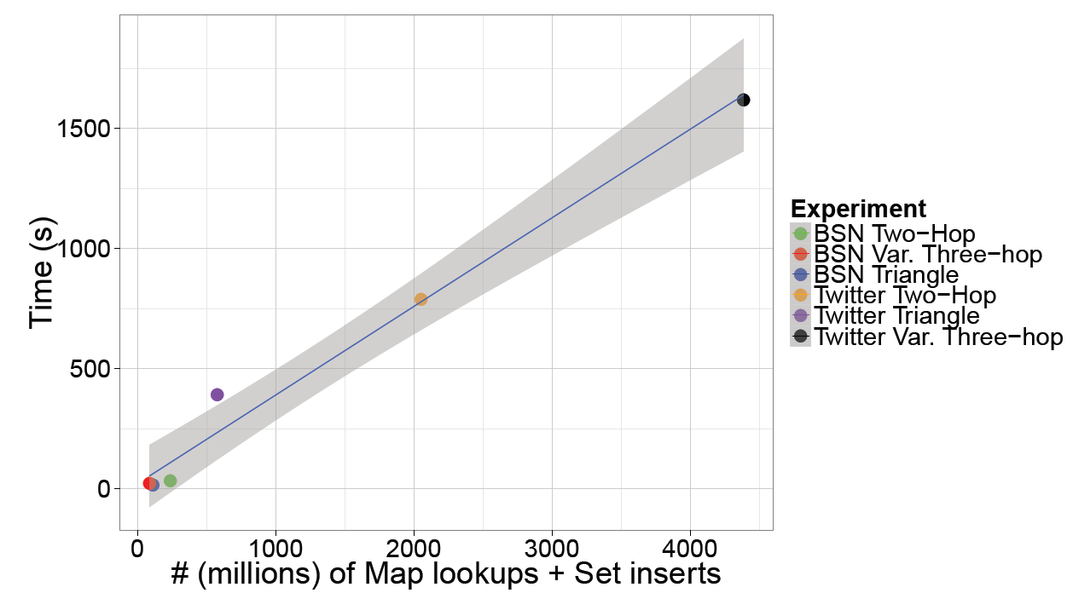
Experiments

Slide 17
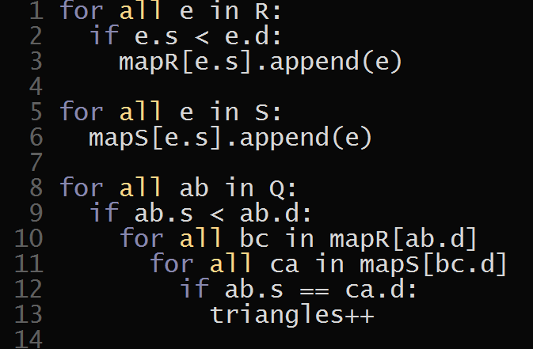
Parallelism in execution plans
Inter-pipeline
Intra-pipeline
Q[0..10)
Q[0..5) Q[5..10)
[0..3) Q[3..5)

Slide 18
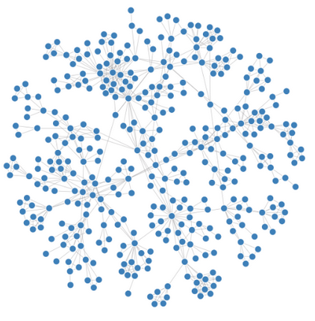

unpredictable memory access
load imbalance
lots of parallelism
source:
http://vis.stanford.edu/papers/graphprism

Slide 19
unpredictable memory access
load imbalance
lots of parallelism
source:
http://vis.stanford.edu/papers/graphprism

Slide 20
Targeting Grappa
Grappa application (e.g., BFS, tree search, sort, PageRank)
memory distribution
remote memory operations
task spawns & parallel loops
Fine and course synchronization
Buffered communication
Fast threading
Automatic load balancing

Slide 21
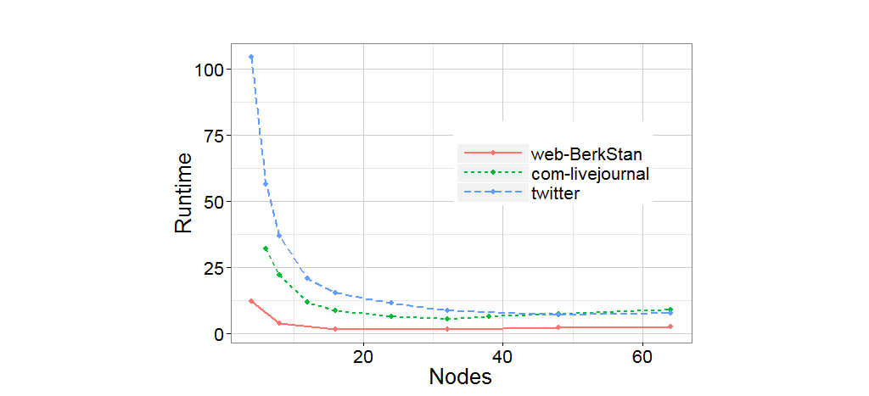
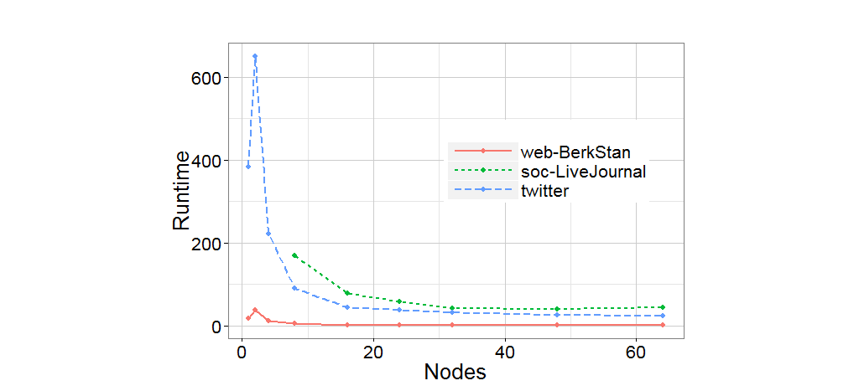
Query runtime on Grappa
2H(a,b)
Tri(a,b,c)
Postgres (3128s)
Postgres (1919s)
serial c++ (790s)
serial c++ (392s)

Slide 22
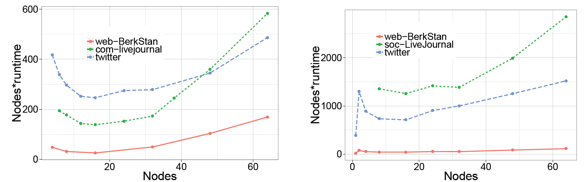
Scalability of Grappa
2H(a,b)
Tri(a,b,c)

Slide 23
Parallel system performance

Slide 24
Grappa-as-a-database Takeaways
Relational model should not be abandoned for for graph queries/data
Demonstrated good performance for generated parallel code on distributed machine
Grappa is an attractive platform for a code generation-based database

Slide 25
Grappa-as-a-database Future work
Supporting more of Datalog for graph queries
Exploring query optimizations
Exploiting domain-specific knowledge in compilation

Slide 27
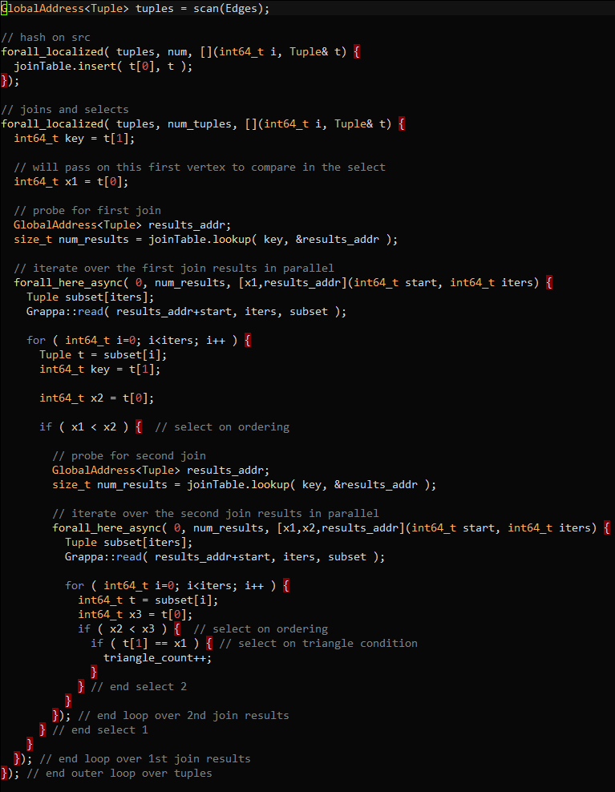
Notes:
triangles

